Slide 1

Numerical Challenges in Efficient Modeling of Colliding Flows
Scott Feister
Postdoc, University of Chicago
OSIRIS Users and Developers Workshop
September 19, 2017

Slide 2
Outline
Discuss new user experience
Technical challenges modeling impinging flows

Slide 3
Introduction: A new user to OSIRIS
Workflow:
Decks:
Git repo for each simulation; contains decks and analysis
Run:
BlueGene/Q and/or Intel supercomputers (hundreds to millions of cores)
Analysis:
Python, Matplotlib, Mpi4py
Learning OSIRIS syntax, boundary conditions, etc.:
Ask Ben Winjum (documentation M.I.A.!)

Slide 4
Uses of OSIRIS
Instability growth at interface of impinging flows
Other interests:
Passing state between FLASH and OSIRIS
LWFA
High-intensity laser interactions with solids/liquids

Slide 5
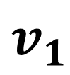
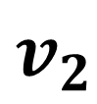
Goal: Study the interface of colliding flows
Material A
$$v_{1}$$
Interaction region takes a while to develop… how to efficiently simulate?
Region of interest
$$v_{2}$$
Material B

Slide 6
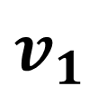
Original deck: Computationally expensive reservoir!
Material A
Reservoir
$$v_{1}$$
Interaction region takes a while to develop… requiring larger and larger reservoirs!
Region of interest
$$v_{2}$$
Reservoir
Material B

Slide 7
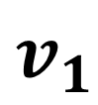
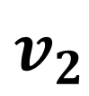
More efficient: don’t model the reservoir particles!
Inflow boundary
$$v_{1}$$
$$v_{2}$$
Inflow boundary

Slide 8

One hitch! I couldn’t get a steady state flow with this test problem… can you?
Inflow
(protons + electrons)
TEST PROBLEM
$$v$$
Outflow
Filamentation instabilities engulfed the flow.

Slide 9
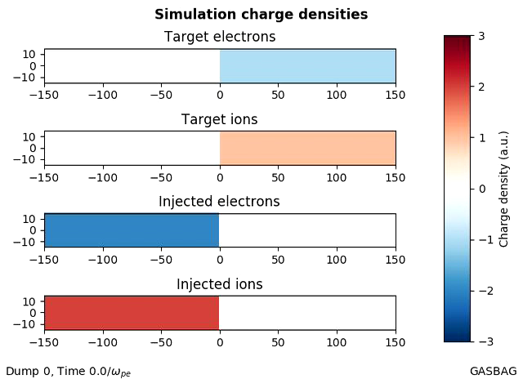
Optimized BG/Q: Introduces numerical instability?
Workaround: I commented out the "SIMD = BGQ" line of compilation as well as changing to SINGLE precision.
Consequence: No instability, but code runs half as fast.
qsub -t $WALLMIN -n 256 --proccount 4096 --mode c16 -A $PROJECT osiris-2D.e input_file

Slide 10
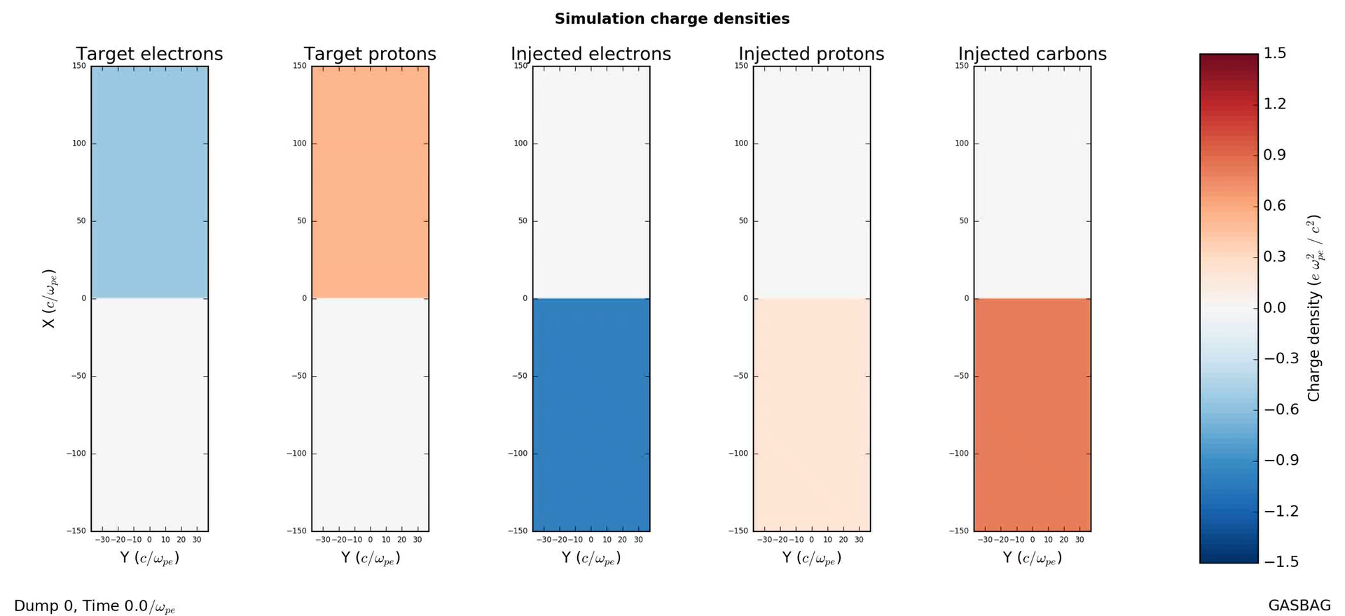
Going back to reservoir scheme, an instability at the boundaries

Slide 11
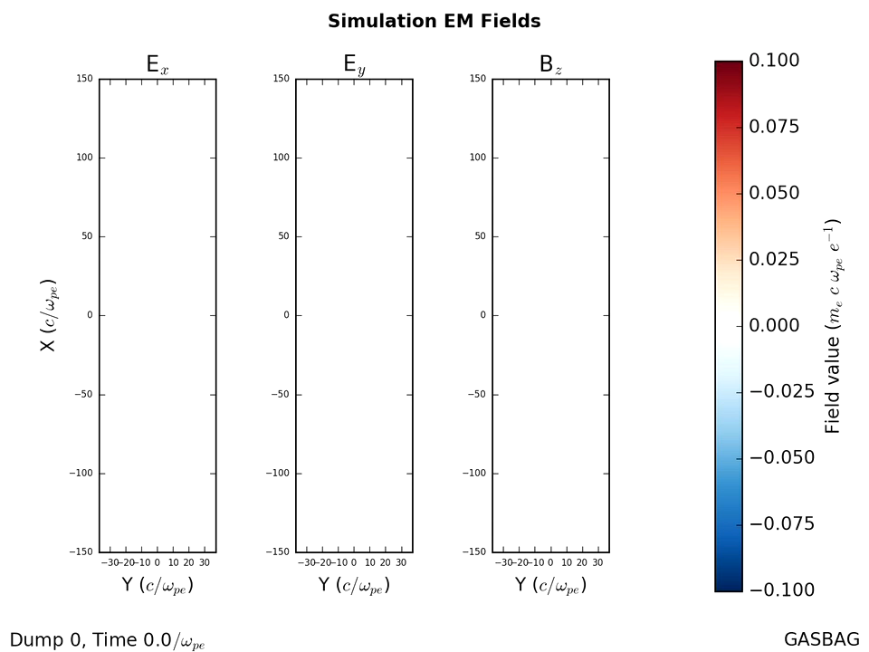
Instability is from lost electrons at edges
Problem: No boundary conditions avoid instability as plasma flow away from edges.
Workaround: Tapered density profile near boundaries.

Slide 12
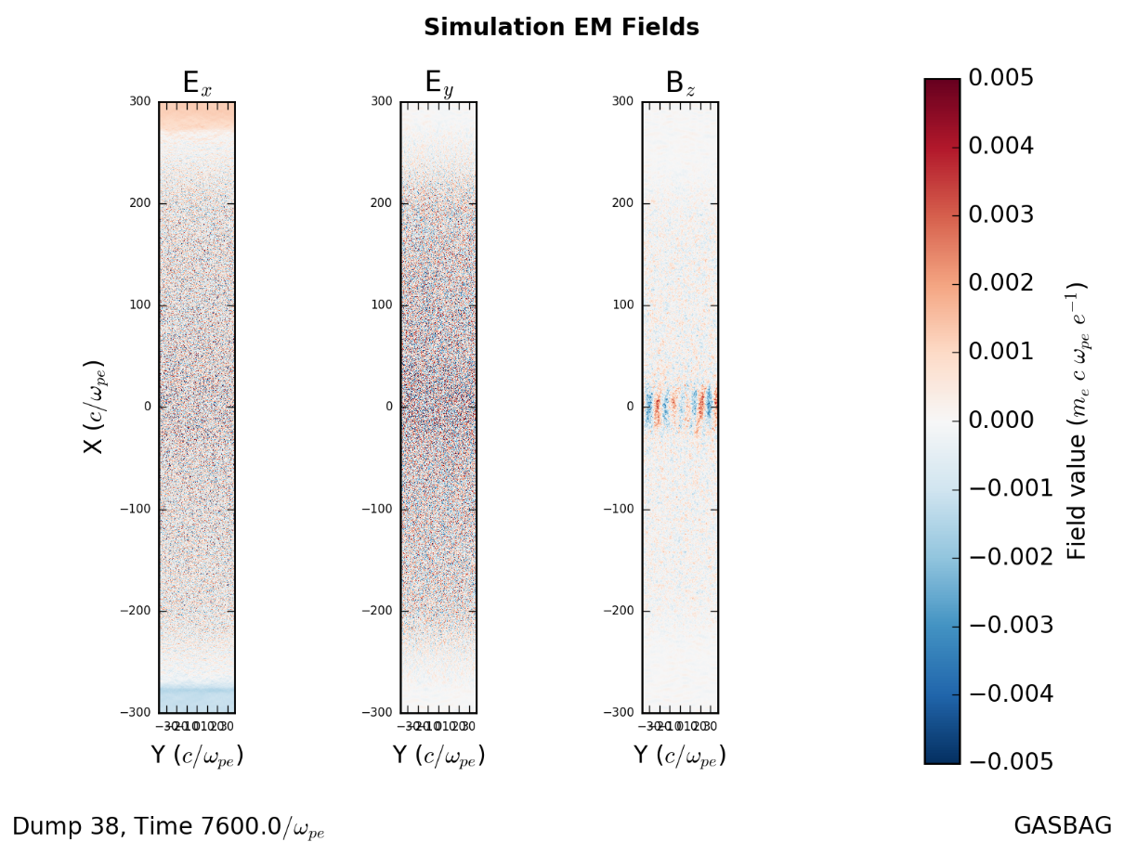
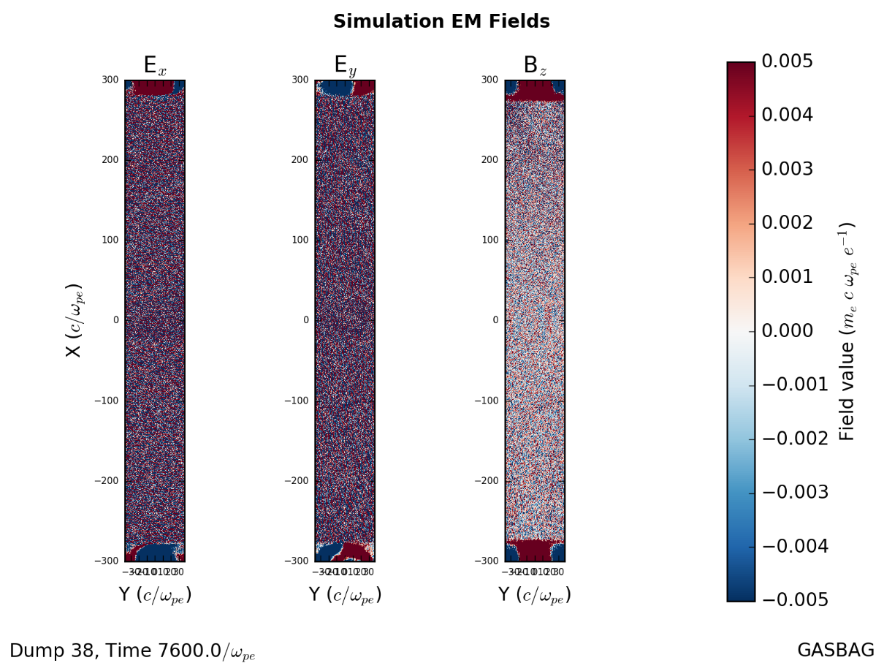
Duct tape solution: taper density near the edges
Density tapers off at top/bottom edges
Density is constant right up to top/bottom edges
AFTER
BEFORE
Noise obstructs signal
Signal is clear
WHY? In part, because target charges up when thermal electrons stick to top/bottom walls.

Slide 13

Conclusion
Glad to be a new member of the OSIRIS user community!
Looking forward to Anton’s talk on documentation
Has anyone implemented a stable “inflow” neutral plasma boundary?
Inflow
(protons + electrons)
$$v$$
Outflow

